Slide 1
System Development Methods CT00046-3-2
System Design – Part 2

Slide 2
Learning Outcome
At the end of the module, you should able to:
Apply UML analysis, design and implementation techniques to develop a simple prototype, with a suitable interface, from conception through to implementation.
Demonstrate a knowledge of the fundamental issues of prototyping by applying standard design principles.

Slide 3
Key Terms you must be able to use
If you have mastered this topic, you should be able to use the following terms correctly in your assignments and exams:
Design Concepts
UML
HCI
Prototyping

Slide 4
Influence of Software Design
Process Centered Design
Designing software based on automation of process
Ex; Ticketing Machine, Manufacturing process, Hotel booking, etc.
Data Centered Design
Designing software based on processing large data.
Ex; Big Data, Shopping, Immigration system, flight management.
User Centered Design
Designing software based on human behavior
Ex; AI, games, social sites, navigation applications, etc.

Slide 5
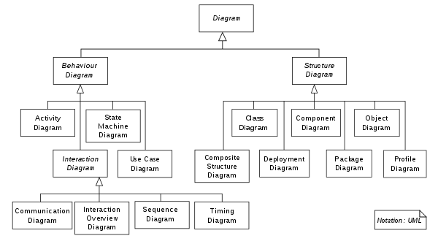
Unified Modeling Language (UML)
Modeling techniques to visualize the design of a system.
Supports Object Oriented development approach.
UML can be used to design, discuss, present and event test a software component before its built.

Slide 6
TWO different views of UML modeling
Static / structural view
Emphasizes the static structure of the system using objects, attributes, operations and relationships.
Used for Data and Process oriented development approach.
Presented through - class and composite structure diagrams.
Dynamic / behavioral view
Emphasizes the dynamic behavior of the system by showing collaborations among objects and changes to the internal states of objects.
Used for User and some Process oriented development approach.
Presented through sequence diagrams, activity diagrams and state machine diagrams.

Slide 7
Prototyping
Process of creating model(prototype) of the system.
Features
Only shows the main interface, functions and features.
Advantage
‘3D’ view of product, capture more problems / opinions
Display for early user feedback / confirmation / satisfaction.
Disadvantage
May cost money and time to create / modify
Developer unclear of the scope of the prototype (end-up over doing it)
Not all function can be seen in a prototype.

Slide 8
Dimensions of Prototyping
Horizontal prototype
Prototype provides a broad view of an entire system or subsystem
Focusing on user interaction more than low-level system functionality, such as database access.
Useful for - demonstration to users and estimating project.
Vertical prototype
Prototype elaborates a single subsystem or function.
It is useful for obtaining detailed requirements for a given function, such as refinement database design.
Useful for - study and testing.

Slide 9
Types of Prototype
Throw-away Prototype
Basic form of prototype, created for demonstration purpose.
Only shows ‘dummy’ representation of the actual product.
Evolutionary Prototype
Entire product is built in stages based on added / changing requirement.
Commonly this prototype is developed to become the final product.
Incremental Prototype
Several prototypes and merged and refined to become final product.
Extreme Prototype
Widely used for Web Development.
Product is delivered in fully functional scale, by stages
Stage 1 - Usually Static Pages (HTML)
Stage 2 – All Functions (Coding)
Stage 3- Other services / components such as database.

Slide 10
Human Computer Interaction (HCI)
Concepts of creating software which are safe and pleasant to use.
Concerns mostly on interface design, between a computer system and user.
Things to consider in HCI;
Users abilities/ disabilities
User’s age group (interest, legal contents, etc)
User’s computer literacy (Novice, Intermediate, Expert)
User’s Socio-culture (perception of color, language, religious sensitivity, etc)
Purpose of Software (Command line, GUI, Interactive, 3D, etc.)

Slide 11
Quick Quiz - HCI
Consider this situation
Designing an educational website for children between 3 to 5 years old.
Why are the design factors that you would consider for this website, in term of:
Color?
Font size?
How any number of words to use? Long sentences?
How would a child enter data?
How would a child receive data from the site?
How would they start the website? Can they remember the web address? Do they need to know any other commands?

Slide 12
Quick Quiz – HCI Possible answer
Why are the design factors that you would consider for this website, in term of:
Color?
Children at that age can only recognize Primary Colors.
Font size?
Doesn’t need to be large, they can still see clearly.
How any number of words to use? Long sentences?
Few, they cant read properly. More pictures and metaphors.
How would a child enter data?
Click on picture, voice reply
How would a child receive data from the site?
Animation, voice reply

Slide 13
Tutorial
List the UML models that you could find. How many have you tried creating? Study the use/function of each model (where and when it should be used).
Match UML Models with corresponding STRUCTUED DIAGRAMS such as DFD. Can you use only UML for an entire project?
What type of prototype would you build for the below systems (and why)?
Mobile based Game.
Lazada type of Website.
A Calculator application for PC.

Slide 14
Next Session
System Implementation

